Slide 1



Aim: How can we critically analyze primary sources?
What do you EXPECT from news sources such as newspapers, TV, news and social media?
Is there real TRUTH in Journalism?
Announcements:
Guns Germs and Steel Reading and Outline Due 9/23

Slide 2
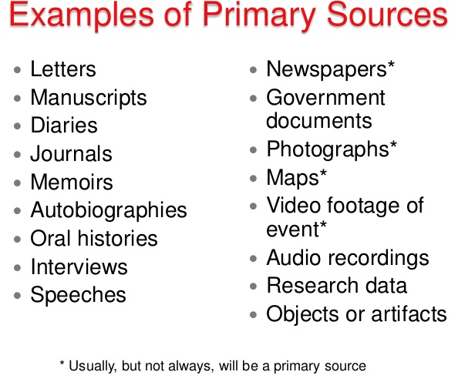

Slide 3


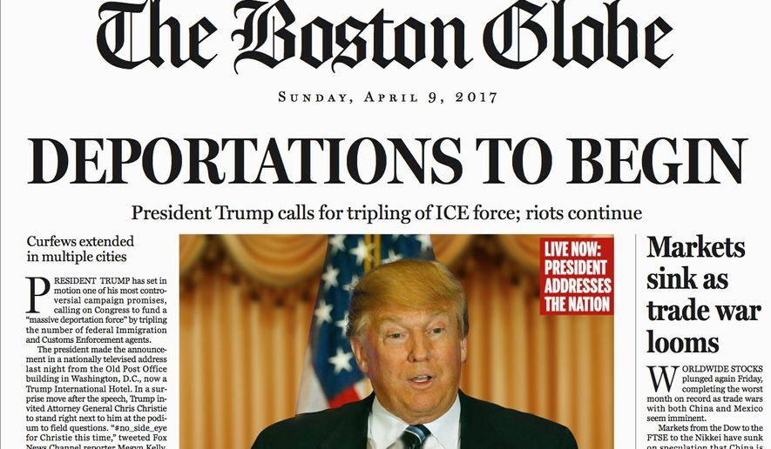
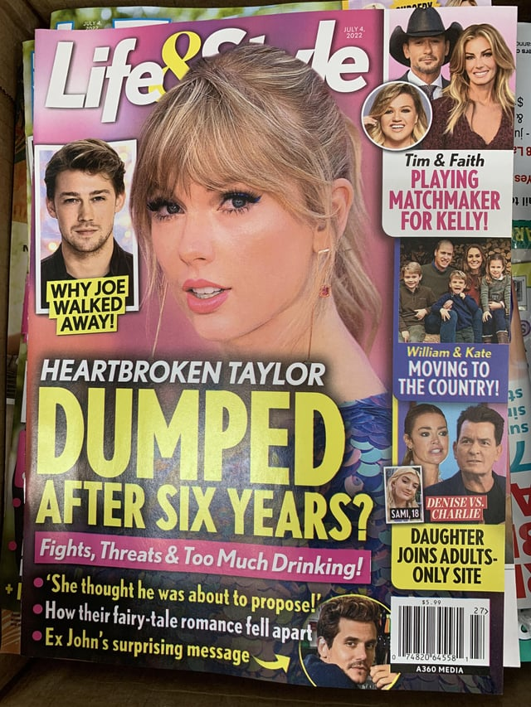
Analyzing Headlines and Photographs- What is the purpose of a Sensational Headline? Hint: Think CLICKBAIT- Why is it so annoying?
“I Gave $100,000 to My Friends!”

Slide 4
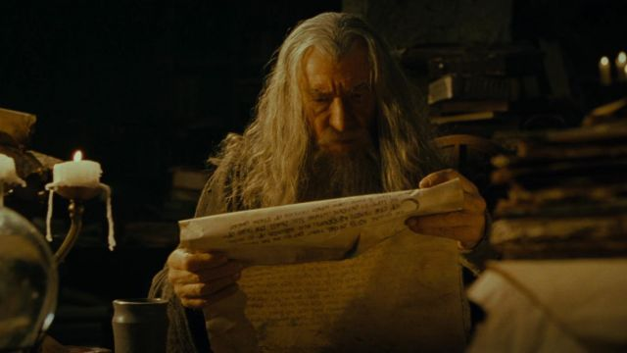
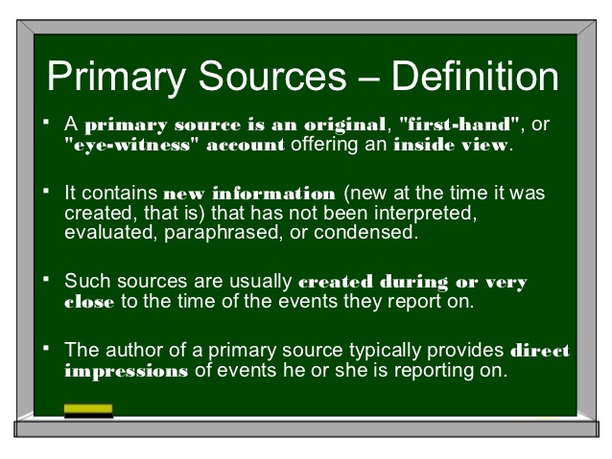
Primary Sources are the main way
we will we study history in this
class. Without them we would
know so little of the world, people
and cultures which existed before
us.

Slide 5
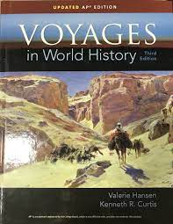
Secondary and Tertiary Sources
2nd Source
3rd Source
Secondary sources are the opinions and analysis of authors who draw conclusions and inferences based off the primary sources.
Guiding Question: How then can a historian ever determine what is truly a fact?
Summarize, list or narrate key facts surrounding historical events. These are usually textbooks or workbooks used to inform students on generally accepted conclusions and information about history.

Slide 6

POV
BIAS
TONE
AUDIENCE
PURPOSE

Slide 7
How to Analyze a Primary Source
Aim: How can we properly analyze primary sources?
You will be reading for more than “information”, but looking for Point Of View.
In order to fully capture the POV of any document- you must assess:
The validity of the author /who wrote it?
Are they an authority on this subject?
What background does the author have? (Gender, ethnicity, class etc.)
Read for bias (Read the language carefully)
Search for tone (superiority, sarcasm, disappointment, pride)
Determine the author’s agenda (What is the overall purpose? persuasive, argumentative?)

Slide 8
Summary- Question #1
Which document is an example of a primary source?
A) textbook on Russian history
B) an encyclopedia article on religions of the Middle East
C)a novel on the Age of Exploration
D)the diary of a survivor of a Nazi death camp

Slide 9
Summary- Question #2
• A book which explores the importance of religion in building a cohesive classical empire.
• Article which analyses and compares Mohandas Gandhi’s political beliefs to Martin Luther King. These two documents are considered…
A) examples of oral traditions
B) primary sources
C)statements of different religious beliefs
D) secondary sources

